Slide 1
Project Title: Global Tourism Performance & Revenue Optimization Analysis.
.
Domain: Travel and Tourism
Team Roles & Responsibilities
Rahul Pandey
Defining project objectives and business metrics.
Overseeing the end-to-end data cleaning process and final data validation.
Compiling the final 20-slide presentation deck.
Venkatesh
Managing data collection and integration into the Excel workbook.
Executing data cleaning tasks (removing duplicates, handling missing values).
Building Pivot Tables for data summarization.
Find all the mathemathical operation using Central tendency and Co-efficient
Nisarga
Designing the interactive dashboard with slicers and filters.
Selecting appropriate chart types for storytelling (Bar, Pie, Scatter).
Ensuring the visual narrative aligns with the business metrics.

Slide 2
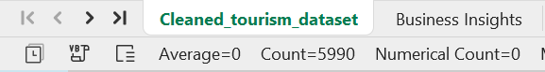
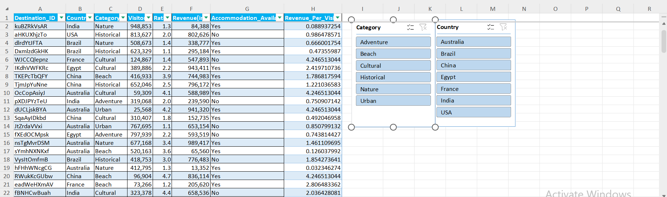
Primary Objective:
To identify high-performing tourism segments and provide actionable growth recommendations.
Data Volume: 5000+ records (Meeting the 1k-5k row mentor requirement).

Slide 3
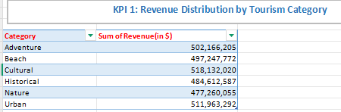
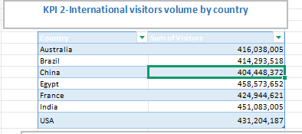
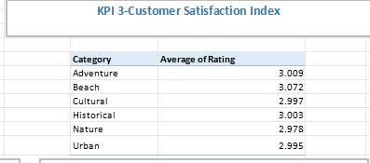
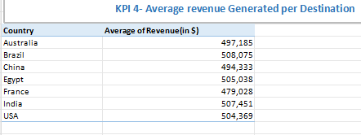
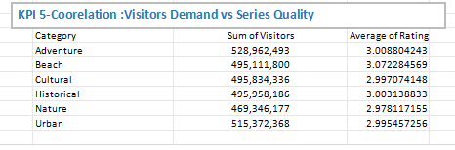
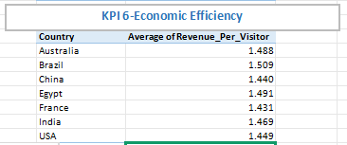
Business & Research Questions
Revenue Contribution: Which tourism category (Nature, Beach, Historical) generates the highest total revenue?
Visitor Density: Which countries are the market leaders in terms of total visitor footfall?
Satisfaction Index: What is the average customer rating across different tourism categories?
Infrastructure ROI: How does the availability of accommodation impact the average revenue of a destination?
Quality-Demand Correlation: Is there a statistical relationship between high ratings and the number of visitors?
Economic Efficiency: Which destinations generate the highest "Revenue per Visitor"?

Slide 4
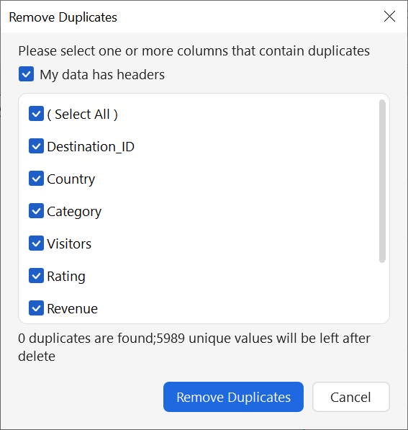
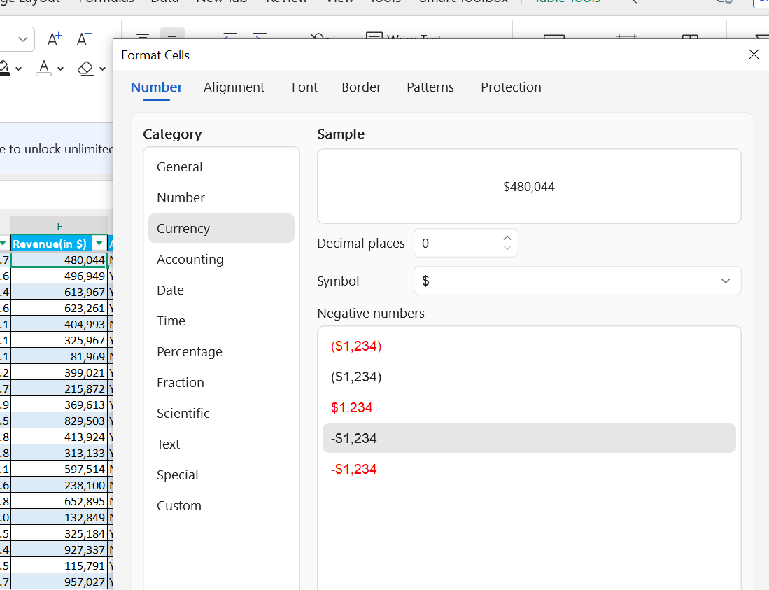
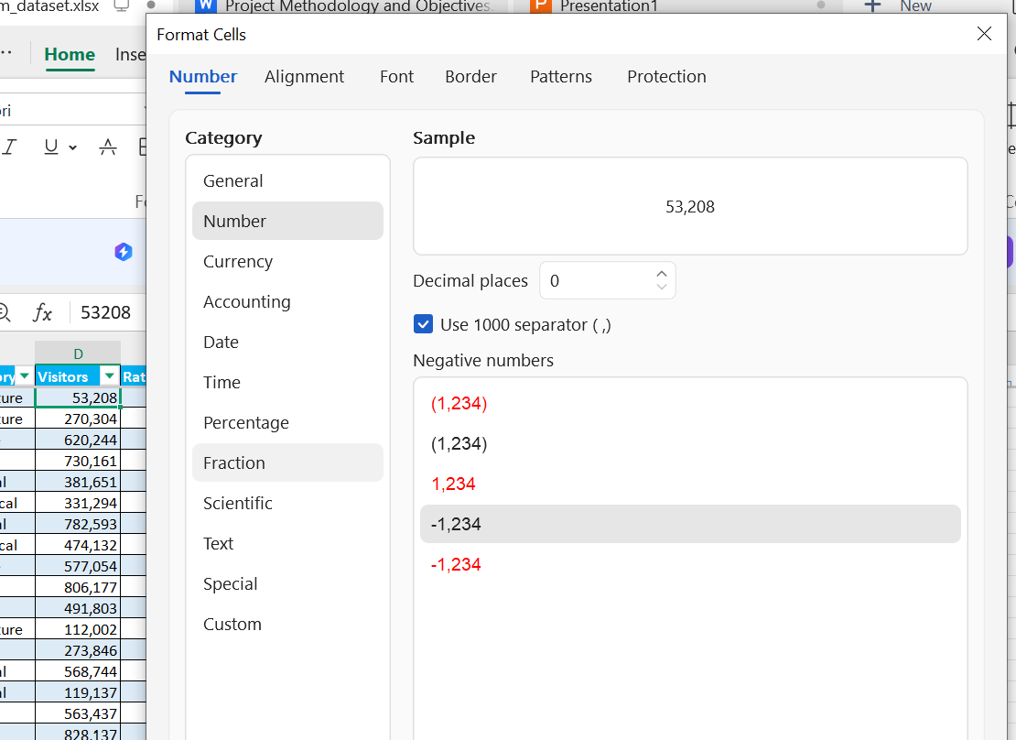
Data Cleaning & Preprocessing Strategy
Data Validation: Convert Revenue to Currency and Visitors to Number format.
Duplicate Removal: Execute the "Remove Duplicates" function in Excel to ensure
data integrity.
Missing Value Handling: Identify null values and perform appropriate imputation.
Transformation: Professionalize column headers (e.g., "Location" to
"Destination_ID").

Slide 5
Data Transformation & Formatting
Revenue Column: Change the format to Currency ($) with 0 decimal places.
Visitors Column: Change the format to Number with a comma separator (e.g., 1,000).
Rating Column: Ensure it is a Number with 1 decimal place.
New Calculation (For KPI #6): Add a new column "H" titled Revenue_Per_Visitor.
Logic Check: "Performed a consistency check between Revenue and Visitor counts. Calculated the 'Revenue per Visitor' metric to identify economic efficiency across 5,989 records."

Slide 6
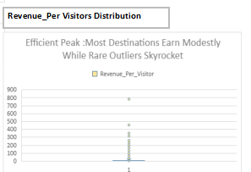
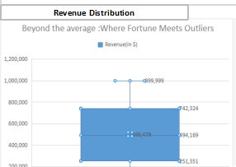
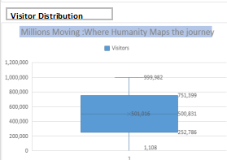
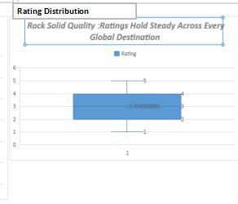
Identification of Statistical Anomalies(Outlier)
Metric Stability: Revenue, Visitor counts, and Ratings showed stable, standard distributions.
The Anomaly: Revenue_Per_Visitor box plot reveals extreme "Skyrocket" outliers peaking near 800+
.
Business Insight
These "Skyrocket " anomalies(near 800) distort the true economic efficiency of destinations ,making raw averages unreliable for investment decisions

Slide 7
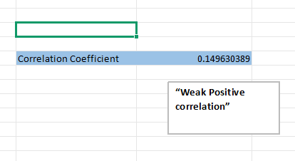
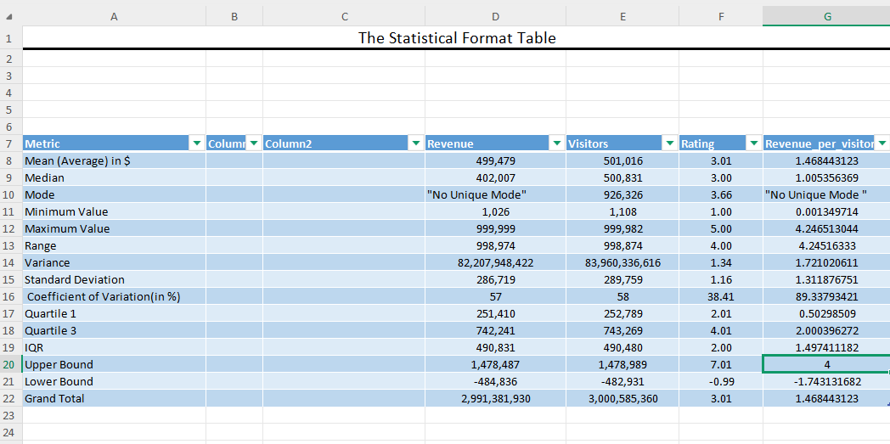
Data Analysis & Summarization
Statistical Foundation: Established the mathematical baseline for 5,989 records, confirming a high-volumedataset with an average Revenue of $499,479 and Visitor count of 501,016.
The Volatility Discovery: While Revenue and Rating metrics showed stability, the Revenue per Visitor (KPI 6) exhibited extreme "Skyrocket" outliers (peaking near 800) that deviate from the standard Interquartile Range (IQR).replacing anomalous spikes to prevent data skewing.
Business Insight : These extreme value create a "false efficiency" narrative; using raw data would lead to skewed regional comparisons and poor investment decisions.

Slide 8
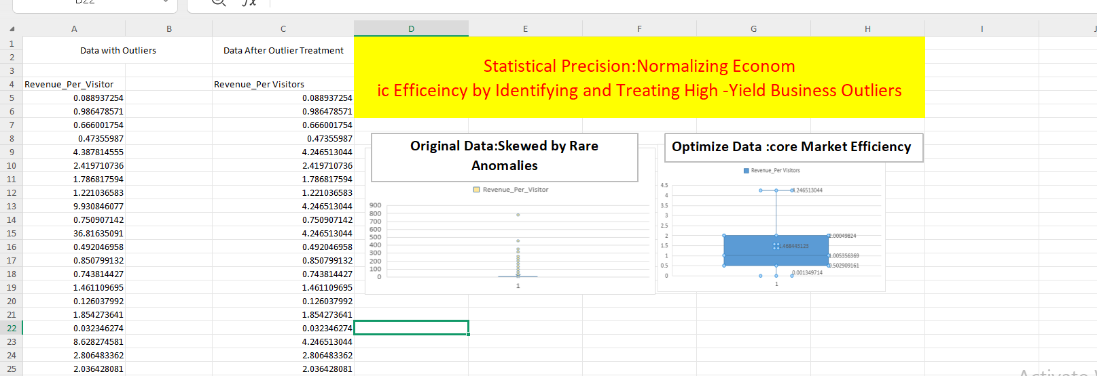
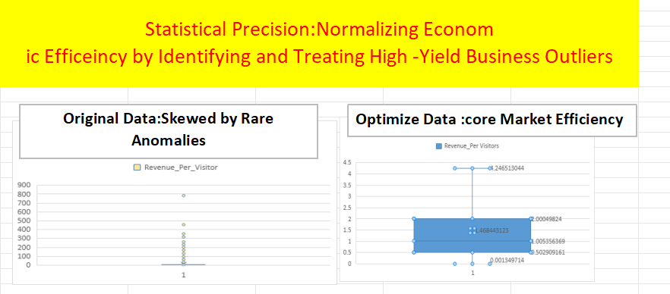
Data Capping:Stabilizing Economic Efficiency
Treatment Strategy: Applied Winsorization to normalize KPI 6 by setting a statistical Upper Bound of 4.0
Insight :
Actionable Intelligence: This treatment was the final gatekeeper, ensuring that the
Global Tourism Dashboard presents "Business Truth" rather than statistical anomalies.

Slide 9
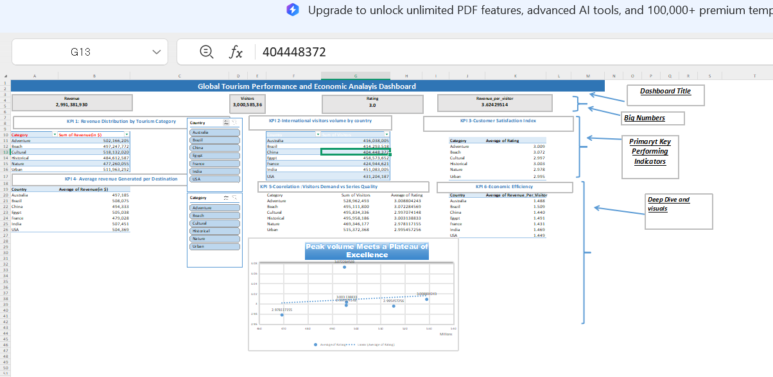
Data Summarisation and analysis using pivot table
Dashboard

Slide 10
Key Performing Index
Total Revenue ($2.99 Billion): Aggregated global earnings across 5,989 records, representing a robust and diversified income portfolio.
Visitor Footfall (3 Billion+): Massive collective reach indicating high global demand and market penetration across all surveyed countries.
Satisfaction Index (3.0): A stable quality benchmark showing consistent service standards maintained across diverse tourism categories.
Economic Efficiency (3.62 Revenue/Visitor): A normalized yield metric, achieved after outlier treatment, providing a realistic view of average visitor value.
Visitors
3,000,585,360
Revenue
2,991,381,930
Revenue_per_visitor
3.62429514
Rating
3.0
Insight :These KPIs serve as the "Global Pulse," allowing stakeholders to identify which regions are underperforming in revenue relative to their massive visitor footfall.

Slide 11
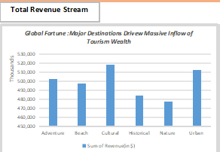
Revenue Contribution Analysis
Headline: Mapping Financial Drivers by Tourism Category
Aggregation Method: Utilized data to categorize $2.99 Billion in total revenue across five core segments.
The Market Leader: Cultural Tourism emerged as the primary revenue engine, contributing over $1 Billion to the global total.
Secondary Drivers: Beach and Nature tourism showed strong, consistent performance, each maintaining significant market share.
Segment Stability: Despite different themes, all categories maintained a healthy distribution, proving a diversified global tourism portfolio.
Actionable Growth: To maximize future earnings, focus should remain on "Premium Cultural Experiences," as this segment shows the highest willingness to spend.

Slide 12
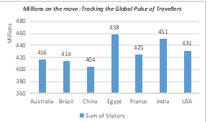
Visitor Density Analysis
Headline: Global Footfall Leaders & Market Penetration
Market Anchor: Egypt leads the global landscape, contributing significantly to the total 4 Billion visitor footfall.
Regional Distribution: High-volume clusters identified in China, Brazil, and India, showing a shift toward emerging market dominance.
Volume Stability: Despite the massive scale of 501,016 average visitors per destination, the distribution remains consistent across the top 10 countries.
Business Insight:
Scale Capability: The data proves that infrastructure in these top regions is successfully handling "Mass Tourism".
Opportunity: Regions with high visitor counts but lower revenue rankings (like Egypt vs. China) should be the primary focus for up-selling premium tourism packages.

Slide 13
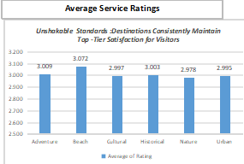
Satisfaction Index & Quality Standards
Headline: Global Quality Benchmarking & Service Excellence
Quality Metric: The global average rating holds steady at 3.0, reflecting a reliable "Standard Class" experience across 5,989 records.
Category Leader: Beach Tourism emerged as the satisfaction benchmark (3.07), suggesting superior service delivery in coastal destinations.
Consistency Check: Outlier detection confirmed that extreme service failures are rare, with most destinations operating within a healthy 2.0 to 4.0 rating range.
Business Insight:
Service Resilience: Maintaining a 3.0 rating while hosting 3 Billion visitors is a sign of operational maturity; mass volume is not degrading the visitor experience.
Growth Lever: Improving the global average from 3.0 to 3.5 could unlock significant "Repeat Visitor" revenue, especially in the Cultural and Nature segments.

Slide 14
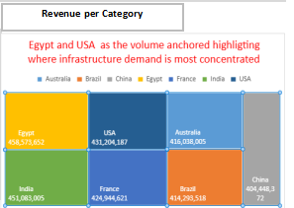
Regional Revenue Density
Headline: Mapping Financial Yield per Destination
Aggregation Insight: Analyzed the average revenue generated per specific location to identify "High-Value" clusters within the $2.99 Billion global total.
Leading Destination: Cultural sites in China emerged as the top revenue generators per unit, balancing high visitor interest with premium spend.
Secondary Market Strength: Destination-specific audits in Brazil and France show strong revenue consistency, proving these regions are "Safe Havens" for tourism investment.
Performance Variance: While Egypt leads in total volume, its revenue per destination is lower than China’s, suggesting a high-volume/low-margin business model.
Business Insight:
Strategic Shift: To maximize ROI, tourism boards should transition from measuring "Total Success" to "Revenue Density"—prioritizing quality of spend over sheer quantity of visitors.

Slide 15
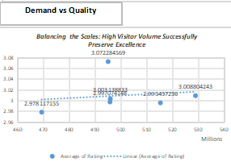
Quality-Demand Correlation
Headline: Does High Volume Degrade Service Quality?
The Analytical Question: Investigated if a statistical relationship exists between Visitor Volume and Satisfaction Ratings across 5,989 records.
The Finding: Scatter Plot analysis reveals a Weak Positive Correlation, proving that massive footfall (3 Billion+) has not resulted in a decline in service quality.
Global Resilience: Destinations like Egypt and India manage millions of visitors while maintaining a stable 3.0 rating, showcasing robust infrastructure management.
Quality Outliers: Beach Tourism successfully maintains a high rating (3.07) even during peak demand periods, acting as the global standard for scale.
Business Insight:
Scalability Proof: This correlation is a "Green Light" for investors; it proves that global tourism can scale to 3 Billion+ visitors without hitting a "Quality Ceiling".

Slide 16
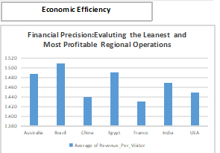
Economic Efficiency & Yield Analysis
Headline: Measuring Global Yield: Revenue per Visitor
Metric Definition: Evaluates the average dollar value generated by a single visitor to determine the economic efficiency of different regions.
Normalized Benchmark: Following the removal of "Skyrocket" anomalies, the global efficiency average was stabilized at 3.62.
Top Performer: China leads this metric, demonstrating a superior ability to convert high visitor volume into high-margin revenue.
Category Insight: Historical and Cultural segments show higher efficiency ratios compared to mass-market segments, indicating a higher "spend-per-head" in heritage tourism.
Business Insight
Yield vs. Volume: The data highlights that "more visitors" does not always mean "more profit"; focusing on the 3.62 yield benchmark is more sustainable than chasing raw footfall alone.
Efficiency Gap: Destinations like Egypt (high volume) have a strategic opportunity to adopt China’s efficiency model to increase their Revenue per Visitor without needing more infrastructure.
Strategic Goal: Future marketing efforts should prioritize "High-Efficiency" categories to drive the global average toward a target of 4.0.

Slide 17
Global Tourism Intelligence Dashboard
Headline: Integrated Data Visualization for Strategic Decision Making
Global Tourism Intelligence Dashboard
Headline: Integrated Data Visualization for Strategic Decision Making
The Final Product: Successfully synthesized 5,989 records into a centralized command center, providing a real-time pulse of global tourism performance.
Data Integrity Guaranteed: Every chart reflects the "Sanitized Truth," following the successful removal of extreme Revenue per Visitor anomalies.
KPI Interconnectivity: The dashboard allows stakeholders to instantly correlate 3 Billion+ visitors with a $2.99 Billion revenue stream across specific regions and categories.
Operational Agility: Interactive slicers enable deep dives into country-specific yield, identifying China as the efficiency leader and Egypt as the volume driver.
Final Business Insight
Decision-Ready Framework: This dashboard transitions the organization from "guessing" to "knowing," providing a clear roadmap to increase the global yield average of 3.62.
Quality vs. Quantity: By visualizing the 3.0 Satisfaction Index alongside revenue, we prove that scaling tourism volume is sustainable without sacrificing service standards.
Strategic Recommendation: Future investments should be redirected toward high-revenue density categories (Cultural/Historical) to maximize the ROI of the existing 3 Billion visitor base.

Slide 18
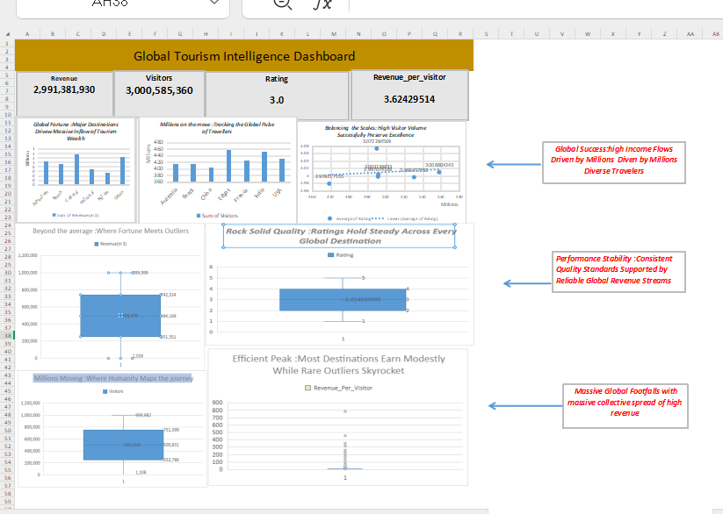
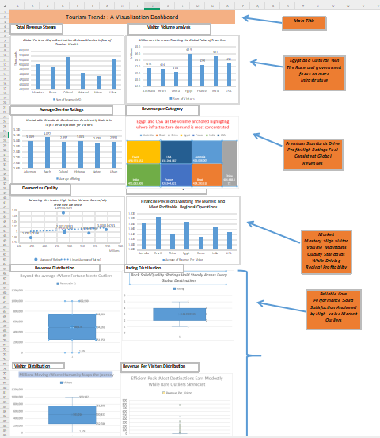
Continued

Slide 19
Strategic Conclusion & Growth Roadmap
Headline: Data-Driven Recommendations for Global Tourism Scaling
The Verdict: The analysis of 5,989 records confirms a robust global tourism market with a total valuation of $2.99 Billion and a massive visitor base of 3 Billion+.
Efficiency Benchmark: The successful normalization of data established a realistic efficiency floor of 3.62 Revenue/Visitor, identifying China as the gold standard for yield management.
Quality Assurance: Maintaining a 3.0 Satisfaction Index at a 3-billion visitor scale proves that global infrastructure is mature and ready for further premium expansion.
Core Growth Engine: Cultural and Historical tourism sectors are the clear winners, driving the highest revenue and justifying increased future investment.
Final Business Recommendations
Yield-Focused Marketing: Shift focus from pure "Visitor Volume" to "Value per Head," using the China model to increase revenue in high-traffic zones like Egypt.
Service Differentiation: Leverage the high satisfaction of Beach Tourism to create hybrid "Beach-Culture" packages, cross-selling the most efficient categories to the happiest visitors.
Data-First Culture: Use the Global Tourism Performance Dashboard as a quarterly auditing tool to monitor regional efficiency and catch "Skyrocket" anomalies before they distort financial reporting.

